Slide 1
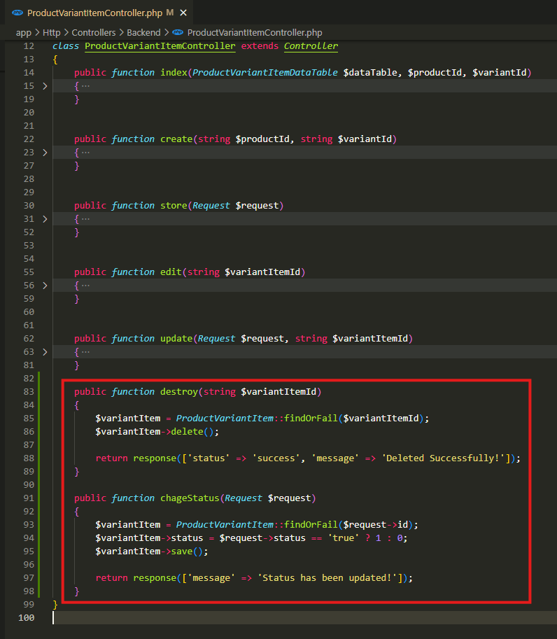
app\Http\Controllers\Backend\ProductVariantItemController.php

Slide 2
.

Slide 3
.

